Slide 1
By Miguel Hidalgo © 2018
General Overview Of Process Improvement Methodologies and How they Fit in Traditional (WF) Project Management

Slide 2
Training Objectives
Increase understanding of the Process Improvement methodologies/approaches, Lean and Six Sigma.
Increase understanding of the basic Lean tools.
Increase understanding of DMAIC projects and how they fit in the Traditional (WF) project management.
Understand how to use basic tools for project management in DMAIC projects.
Understand how to apply easy PM techniques that will increase the success of your DMAIC projects.
Understand that what was presented is the tip of the iceberg with respect to Professional Project Management Methodologies/Practices and Process Improvement Methodologies/Practices, etc.

Slide 3

TEAMWORK

Slide 4
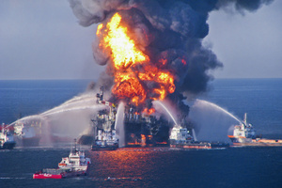
Murphy’s Law
Anything that can go wrong,
WILL GO WRONG!
So, Have a Contingency Plan!
(Manage Risk)

Slide 5
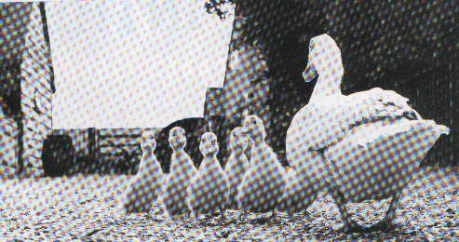
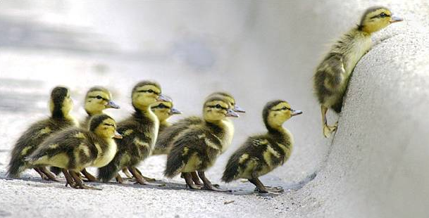
Leadership
Leading ordinary people to accomplish extraordinary things!

Slide 6

PLANNING
Being prepared
is
50% of the Victory

Slide 7
What is a Project?
A temporary (start, execute, end) endeavor undertaken to create a unique product or result.
What is Lean?
A systematic approach to identifying and eliminating waste through continuous improvement by flowing the product or service at the pull of the customer in pursuit of perfection.
What is Six Sigma?
Six Sigma is a rigorous and disciplined methodology that uses data and statistical analysis to measure and improve a company's operational performance by identifying and eliminating "defects" in manufacturing and service-related processes.”

Slide 8
Six Sigma & Lean Tools
Six Sigma Tools, Techniques and Principles
Lean Tools, Techniques and Principles
DMAIC Methodology
Project Management
Variability Reduction
Statistical Process Control
Measurement System Analysis
Design of Experiments
Regression Analysis
Analysis of Variance
Hypothesis Tests
Process Mapping
More…
Waste Identification & Elimination
5 S Practice
SIPOC Process Mapping
Visual Management
Standardized Procedures
Value Stream Mapping
Kaizen
Pull System (Kanban)
Total Productive Maintenance (TPM)
Just-in-Time
More…

Slide 9
What is Project Management?
The Application of knowledge, skills, tools, and techniques to project activities to meet the project requirements.
What is DMAIC?
A structured problem-solving methodology

Slide 10
Lean Building Blocks
Continuous Improvement
Pull/Kanban
Value Stream Mapping
VOC
Quality at Source
A3
3Cs/5 Why’s
Standardized Work
Waste Elimination
PDCA
5S System
Visual
Plant Layout
More…

Slide 11
Lean Practical CPI Tools
Waste Identification and Elimination (TIMWOOD)
Brainstorming
3C’s (Cause, Concern, Countermeasure)
PDCA (Plan, Do, Check, Act)
5S’s (Sorting, Set in order, Shine,
Standardize, Sustain)

Slide 12
Types of Business Activities
Value Added Activity [VAA]: (Maximize)
An activity that increases the value of a service or product. A customer must be willing to pay for it to be considered “value added”.
Non-Value Added [NVA]
Required: (Minimize/Optimize)
Any work carried out which is necessary, but does not increase the product value. A customers does not pay.
Not required - Waste: (Eliminate)
All other non-essential activity.
Notes:
12

Slide 13
Types of Business Activities

Slide 14
Types of Waste
Transport
Inventory
Motion
Waiting
Overproduction
Over-processing
Defects
An easy way to remember the 7 main wastes is
TIMWOOD
Notes:
14

Slide 15
Types of Waste
CAUSES
Large batch size
Uneven planning
Lack of workplace organization (6S/5S)
Poor communication
Transport
Inventory
Motion
Any material movement that does not
directly support a synchronous
manufacturing or service system
Prior stock outages
Incapable suppliers
Long lead times
Management decisions
Local availability
Inaccurate planning
Any supply in excess of process
requirements necessary to produce
goods or services, “Just in Time.”
Layout of office, warehouse, or yard
Lack of workplace organization (6S/5S)
Inconsistent work methods
Inconsistent batch sizes
Any movement of people or
equipment which does not add value
to the product or service.
Notes:
15

Slide 16
Types of Waste
CAUSES
Inconsistent work methods
Poor process discipline
Lack of appropriate machines
Poor coordination
Poor planning
Poor visibility
Waiting
Overproduction
Over-processing
Idle time that is produced when two
dependent variables are not fully
synchronized.
Having excess equipment versus
future demand/customer needs
Blindly servicing product A when product B is in greater demand and in shorter supply
Poor planning
Lack of co-ordination/communication
Decision making at inappropriate levels
Ineffective standards or procedures
Lack of customer input concerning requirements.
Effort which adds no VALUE to a
product or service.
Notes:
16

Slide 17
Types of Waste
Defects
CAUSES
Inadequate training/experience
Extreme pressure
Lack of proper information/communication
Incapable resources
Deviation from standard operations
Equipment or service which does not
fulfill customers requirements.
Notes:
17

Slide 18
Brainstorming
What
A structured method of generating ideas and engaging a team in the improvement process
Why
Brainstorming produces many ideas/solutions in a short time
Facilitates the creative thinking process
Separates idea generation from challenging, debating, and analysis
How
Review the problem definition
Clarify the goal/question and provide any relevant information
Have participants write down ideas as they think of them
Gather ideas, round-robin, one at a time, via post-it notes &/or flip charts - No discussion of ideas until session is complete
Write down every idea
Organize ideas into groups and prioritize the group with the higher relevance

Slide 19

3 C’s – Concern, Cause, Countermeasure
To illustrate this difference, consider a visit to your doctor.:
You feel like you have a cold, runny nose, headache,
etc.
You visit the doctor
The doctor diagnoses a sinus infection, gives you
medication to relieve it. The cold symptoms and
headaches eventually fade and the condition
subsides.
A month later the condition recurs. You pay another
visit to the doctor and are prescribed the same
medication.

Slide 20
3 C’s – Concern, Cause, Countermeasure
This remedy clears up the symptoms of the
problem but does nothing to eradicate the
cause.
Relate this situation to your work
environment and you will realize the effort
and resources being wasted are doing
nothing more than relieving the symptoms for
a period of time.
In the majority of cases when first examining
a problem, we see the effect of the problem
(the cold/headeache) and not the cause (the
allergies).

Slide 21
3 C’s – Concern, Cause, Countermeasure
Iceberg
Symptoms
Effect
Cause
Problems
The Real
Problem
Problem Recognition Examines the EFFECT not the CAUSE

Slide 22
Brainstorming
5 WHYs
Why are you getting sick?
I am getting a cold
I am getting a sinus infection
Why are you getting a cold and/or sinus infection?
I was exposed to a cold virus
My sinuses over secreted phlegm
Why your sinuses over secreted phlegm?
Allergy reaction
Why are you having allergy reactions?
I am being exposed to allergens
Why are you being exposed to allergens?
I like the outdoors

Slide 23
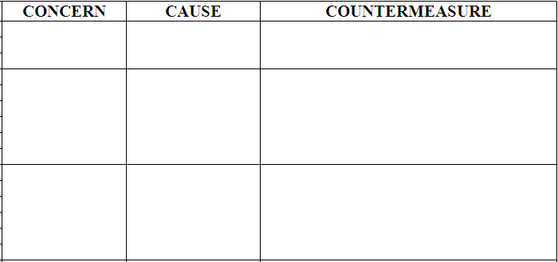
3 C’s – Concern, Cause, Countermeasure
BRAINSTORM
Cold
Sinus Infection
Allergies
Getting sick
Cold
Take cold medicine
Sinus infection
Take antibiotics
Allergies
Take antihistamine
Immune-therapy shots
Prevent exposure to
allergens

Slide 24
PDCA CYCLE
4-Act
1-Plan
A
P
C
D
3-Check
2-Do

Slide 25
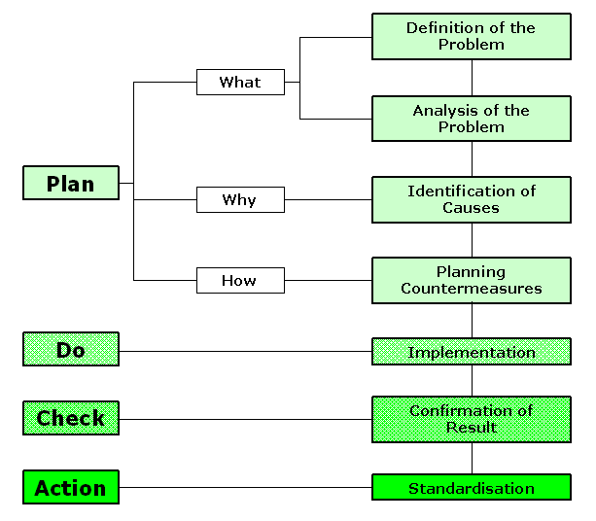
PDCA CYCLE
Brainstorm
“Why the
problem exists?”
Define the Problem
Analyze Problem or Concern
PLAN
Identify Causes
Use the 3C’s Tool
Planning Countermeasures
DO
Implementation
CHECK
Confirmation of Results
ACT
Standardization

Slide 26
5 S’s CYCLE
4- STANDARDIZE
1- SORT
SUSTAIN
5
3- SHINE
2- SET IN ORDER

Slide 27
5 S’s CYCLE
4- STANDARDIZE
Adapt and create a habit (repetitive and consistent) of the method used for Sorting, Set in order and shine
1- SORT
Distinguish needed items from unneeded and eliminate the latter
5-SUSTAIN
Maintain
established
procedures
3- SHINE
Keep area clean and neat
2- SET IN ORDER
Keep items in the correct place for easy access

Slide 28
What is Project Management?
The Application of knowledge, skills, tools, and techniques to project activities to meet the project requirements.
What is DMAIC?
A structured problem-solving methodology

Slide 29
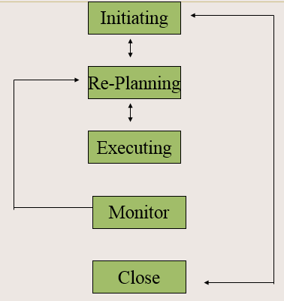
Five Managerial Activities
Five Phases
DEFINE
MEASURE
ANALYZE
IMPROVE
CONTROL
5 phases from defining a problem to implementing solutions with emphasis on sustaining them

Slide 30
DEFINE
MEASURE
ANALYZE
IMPROVE
CONTROL
DMAIC is…
A structured problem-solving methodology
Used when a product/process is not meeting customer specs
Implemented by CPI personnel with the support of a sponsor
A way to help support the business strategy
5 phases from defining a problem to implementing solutions with emphasis on sustaining them
Define the project goals and customer (internal & external) deliverables
Measure the process to determine current performance
Analyze and determine the root cause(s) of the problem
Improve the process by eliminating non-conformances
Control future process performance
Notes:
GOES TO DMAIC OVERVIEW – after waste activity

Slide 31
DEFINE PHASE
Purpose
Properly define the project’s purpose and scope
Obtain background information about the process & its customers
Answer critical questions
What are we trying to accomplish (mission)?
Is the project scope broad enough to be important but narrow enough to be do-able?
Why are we working on this project?
Who is the customer?
What are the Critical-To-Quality Characteristics?
How does the current process flow?
What are the current inputs & outputs of the process?
What resources are required to complete the project?
When must the project be completed?

Slide 32
DEFINE PHASE
ACTIVITIES: Identify Problem Review Project Charter Gather VOC Select & gather project team Validate financial benefits Develop project plan & schedule Understand current process |  | TOOLS: Project Charter Project Plan SharePoint VOC (Kano) CTQ SIPOC Value Stream Map A3

Slide 33
DEFINE PHASE TOLLGATE
Tollgate review checklist for the DEFINE phase:
Customer requirements and expectations are documented
Project Sponsor is in place
Project Team and resources are in place
Project Charter is approved and signed off
Project Plan is in place
A3 has been initiated
All items must be completed and signed off before proceeding to the MEASURE phase!

Slide 34
MEASURE PHASE
Purpose
Gather information and data about the current situation
Understand the current state of the process
Collect reliable data on process speed, quality and costs
Answer critical questions:
Has the success target been determined - in customer terms?
Have potentially significant process inputs been identified for further screening?
Has a data collection plan been developed for the process inputs & outputs?
What is the baseline performance of the process?
Are the relevant metrics visible and widely accessible?
Have potential quick wins been identified?

Slide 35
MEASURE PHASE
ACTIVITIES: Identify Key Input, Process and Output Metrics Develop Data Collection Plan Collect Baseline data Determine Process Performance Validate Business Opportunity |  | TOOLS: Project Plan & A3 Data collection plan Sampling Brainstorming Affinity diagram Check Sheet Swim-lane mapping Spaghetti diagram Variation analysis

Slide 36
MEASURE PHASE TOLLGATE
Tollgate review Check Sheet for the MEASURE phase:
Key measurements are identified
Data collection has been planned and executed
Process variation is displayed and communicated
Baseline performance is established
Project plan and A3 have been updated
All items must be completed and signed off before proceeding to the ANALYZE phase!

Slide 37
ANALYZE PHASE
Purpose
Identify root causes affecting the key process inputs and outputs
Root Causes have been confirmed with data
Countermeasures have been identified
Answer critical questions:
What are the significant inputs affecting the output of concern (aka CTQCs)?
Are the input processes stable and capable?
What are the underlying sources of process variability?
Are the interactions between inputs identified, understood, and optimized?
Have the Countermeasures been prioritized?

Slide 38
ANALYZE PHASE
ACTIVITIES: Determine critical inputs Identify potential root causes Reduce list of potential root causes Confirm root cause effect on output Estimate impact of root causes on key outputs Identify & prioritize countermeasures |  | TOOLS: Project Plan & A3 Fishbone 5 Why’s 3 C’s Cause & Effect SWOT Histogram Pareto Correlation FMEA Benchmarking Priority ranking

Slide 39
ANALYZE PHASE TOLLGATE
Tollgate review checklist for the ANALYZE phase:
Identification of ‘gaps’ between the current and future states
Communication of gaps in financial terms
Verified and quantified root causes
Prioritization of countermeasures
Updated project plan and A3
All items must be completed and signed off before proceeding to the IMPROVE phase!

Slide 40
IMPROVE PHASE
Purpose
Develop, Test and implement solutions to address the root causes identified in the ANALYZE phase
Use data to validate countermeasures
Learn from pilots of successful countermeasures
Execute full-scale implementation
Answer critical questions:
What improvement actions are necessary to achieve targeted performance levels?
Has a process been established to track implementation - with defined responsibility and target dates?
Are there any obstacles to improvement? Unintended consequences? Indirect effects?

Slide 41
IMPROVE PHASE
ACTIVITIES: Develop potential solutions Select & optimize best solutions Develop future process map(s) Establish operating tolerances for new processes Pilot the solution Develop full-scale implementation & training plans |  | TOOLS: Project Plan & A3 Kaizen event PDCA as a tool Process mapping Implementation plan Training plan Kanban Process balancing

Slide 42
IMPROVE PHASE TOLLGATE
Tollgate review checklist for the IMPROVE phase:
Possible countermeasures generated and tested
Best countermeasure is identified and optimized
Solution(s) approved for further rollout
Implementation plan is defined and ready for execution
Project plan and A3 are updated
All these items must be completed and signed off before proceeding to the CONTROL phase!

Slide 43
CONTROL PHASE
Purpose
SUSTAIN the gains made by standardizing and improving work methods and processes
Hand-off improved process to process owner with procedures to SUSTAIN the gains
Answer the following Questions.
Have mechanisms been put in place to provide ongoing feedback and prevent backsliding?
Are significant characteristics (inputs and process variables) being monitored and improved over time using statistical methods?
Are improvements, lessons learned, and best practices being shared in a systematic fashion?

Slide 44
CONTROL PHASE
ACTIVITIES: Develop SOP’s Implement mistake proofing Create Process Controls Monitor & Stabilize Process Identify lessons learned Create case study Transition project to Process Owner Calculate Financial Benefits |  | TOOLS: Project Plan & A3 5S Process control plan Visual controls Checklist Communication plan SOP publishing Poka Yoke Control charts

Slide 45
CONTROL PHASE TOLLGATE
Tollgate review checklist for the CONTROL phase:
Process Standardisation
Monitoring Plan
Response Plans
Documented Procedures
Transfer of Ownership
Case Study
Lessons Learned
Closed project plan
Benefits Sign Off
All items must be completed and signed off before closure of the project!

Slide 46
.
Traditional PM & DMAIC
PROJECT MANAGEMENT
Clear Outcome Project Charter
of the project, Project Plan
More Certainty of Timeline
Completion time, Comm Plan
The solution has Issue/Risk Register
been agreed while Project Closing
in DMAIC the
solution has to be
determined during the
execution of the project.
A3, Kaizen Event,
PDCA, Process
Mapping, Kanban, VOC
Process Balancing, CTQ
5S, 5 Why’s, Process
Control Plan,
Poka Yoke, SIPOC
Visual Controls, VSM,
Ck. Lists, Control Charts
3C’s, C&E, Hist, Pareto,
FMEA, Priority Ranking
Fishbone, Benchmarking,
Aff-Diag, Ck-Sheet, SLM,

Slide 47
Traditional PM & DMAIC
Project Management & DMAIC:
Project Management is a Superset of all projects and event activities
DMAIC is a methodology/series of activities to solve problem in a structured way, therefore it is a specialized type of project where the general project activities can be applied.
To complete a DMAIC project is required to not only know how to apply PM techniques and practices but also Lean Six Sigma Methods and Tools
The DMAIC process works on Processes and does not end after handover to the process owner, a Control Plan to ensure sustainability is part of the last phase of DMAIC which is hand over to the process owner.

Slide 48
References/Bibliography
A Guide to the Project Management Body of Knowledge (PMBOK® Guide)
The Project Management Institute Website
Exploring Requirements: Quality before Design by Gerald Weinberg
Successful Project Management –Step-by-Step Approach with Practical Examples By Milton D. Rosenau, Jr.
DSDM ATERN Handbook (Agile Project Management)
Lean Six Sigma Methodology
The Lean Six Sigma Pocket Toolbox
Lean Six Sigma Demystified
Many others….

Slide 49
Credentials
J. Miguel Hidalgo:
Master in Business Administration, Concentration in Electronic Commerce Management (OLLU)
B.S. in Computer Science (USL)
B.S. Professional Aeronautics (ERAU)
Certified DSDM Agile Project Management Foundations by APM Group (UK)
Certified Project Management Professional (PMP) by PMI
Certified Lean Sigma Black Belt (Ohio State University)
Certified ITIL V3.0 by APM Group
U.S. Army Veteran

Slide 50
Q & A

